Slide 1
Classification of the gender of Big five survey
Submitted by: Mandy Rosemblaum (ID 305747230) and Efrat Kohen (ID 300385564)

Slide 2
Introduction
Big Five personality traits is a suggested taxonomy, or grouping, for personality traits developed from the 1980s onwards in psychological trait theory. The theory suggest five factors used in common language to describe the human personality:
openness (inventive/curious vs. consistent/cautious)
conscientiousness (efficient/organized vs. extravagant/careless)
extraversion (outgoing/energetic vs. solitary/reserved)
agreeable (friendly/compassionate vs. critical/rational)
neuroticism (sensitive/nervous vs. resilient/confident)
The goal of this project is to build a gender classifier that uses big five personality traits, age and country.

Slide 3
Previous work
The scientific debate on gender differences in personality traits ranges from claiming that gender differences are close to zero¹ to the view that they have been obscured by methodological limitations and are actually very large², and a variety of positions in between³.
Hyde, J.S., 2005. The gender similarities hypothesis. American psychologist, 60(6), p.581.
Del Giudice, M., Booth, T. and Irwing, P., 2012. The distance between Mars and Venus: Measuring global sex differences in personality. PloS one, 7(1), p.e29265.
Lippa, R.A., 2006. The gender reality hypothesis.
Previous works show women report higher levels of Agreeableness, Conscientiousness, Extraversion and Neuroticism. Contrary to predictions from evolutionary theory, the magnitude of gender differences varied across cultures.
Costa Jr, P.T., Terracciano, A. and McCrae, R.R., 2001. Gender differences in personality traits across cultures: robust and surprising findings. Journal of personality and social psychology, 81(2), p.322.
Because the domains of the Big Five are so broad and encompass a variety of personality characteristics, greater specificity is needed to uncover where gender differences truly lie.
Weisberg, Y.J., DeYoung, C.G. and Hirsh, J.B., 2011. Gender differences in personality across the ten aspects of the Big Five. Frontiers in psychology, 2, p.178.

Slide 4
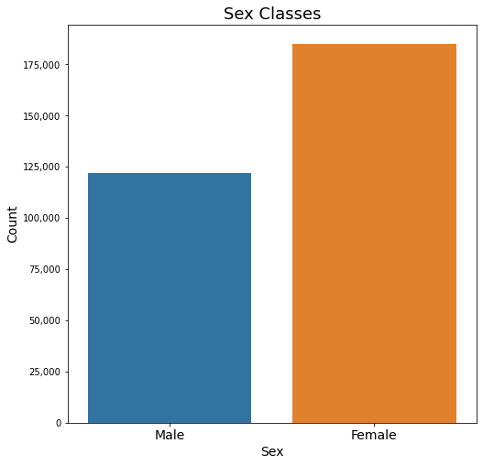
Data
307,313 recorded samples of male’s and female’s big five surveys.
Male: 122,164 samples
Female: 185,149 samples

Slide 5
Data features
Each sample has 8 features:
Country
Age
Sex: 1 = Male, 2 = Female
5 personality traits – values between 0 - 1
case_id | country | age | sex | Agreeable score | Extraversion score | Openness score | Conscientiousness score | Neuroticism score
1 | SA | 24 | 1 | 0.753333 | 0.496667 | 0.803333 | 0.886667 | 0.426667
3 | UK | 24 | 2 | 0.733333 | 0.680000 | 0.786667 | 0.746667 | 0.590000
4 | USA | 36 | 2 | 0.880000 | 0.770000 | 0.860000 | 0.896667 | 0.296667
5 | UK | 19 | 1 | 0.690000 | 0.616667 | 0.716667 | 0.636667 | 0.563333
6 | UK | 17 | 1 | 0.600000 | 0.713333 | 0.646667 | 0.633333 | 0.513333

Slide 6
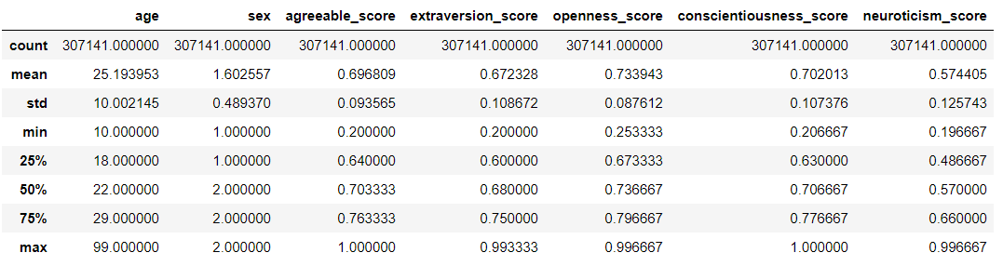
EDA - Mean and quantiles values
The data has172 NaN values in country feature.
After removing rows with NaN values here are the Mean and quantiles values of each numeric feature:

Slide 7
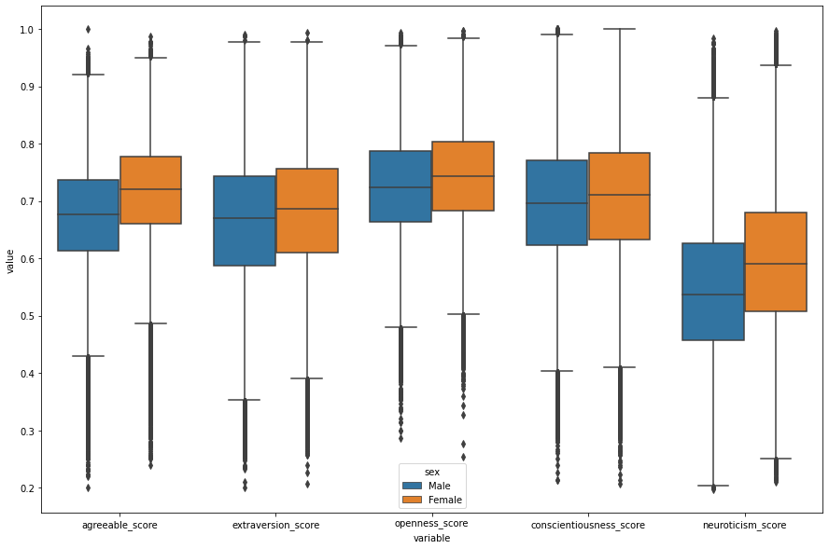
EDA – Box plot of personality traits comparing Male and Female

Slide 8
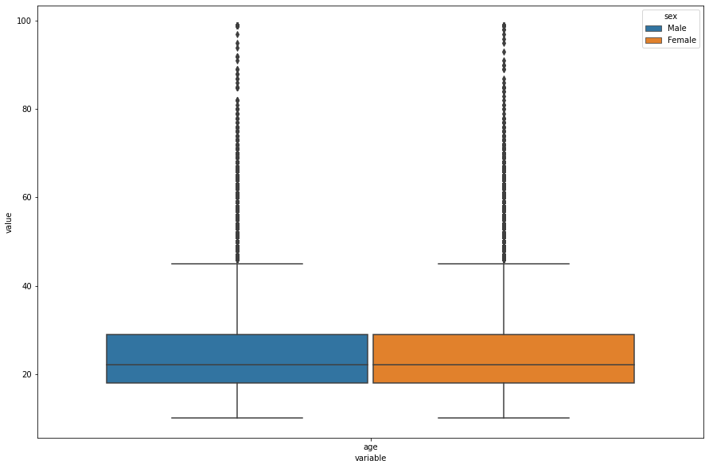
EDA – Box plot of age comparing Male and Female

Slide 9
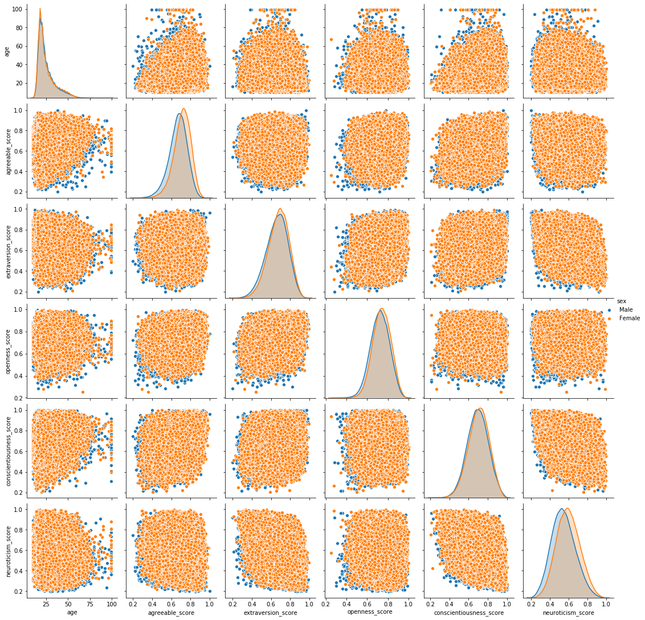
EDA – Pairplot with Male and Female color map

Slide 10
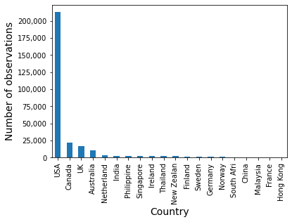
EDA – Top 20 countries histogram

Slide 11
EDA - Conclusions
Gender: The data is not balanced, there are more female observations than male.
Age: Most of the surveys are of young people in their twenties. It's not representative for the world's population.
Countries: USA has most of the observations (69%) and only 11 more countries has more than 0.5% of the observations.
Personality traits: All the personality means of female are a bit higher than male, especially neuroticism and agreeable.

Slide 12
Preprocessing
according to the exploratory data analysis we decided to:
Balance the data by gender
With one-hot encoding we gave a specific feature for only countries with significant number of surveys (more than 0.5%) and all the other countries gather to one feature 'other'.
Normalize the data.
Add new features of multiplication of any two personality scores.
We tried to use PCA for dimensionality reduction, due to similarity of personality traits distributions, but decided not to use it as the results didn't show beneficial output.
We tried to use K-means in order to see if there is a 'cultural' diversity (by countries regions) but decided not to use it has the results didn't show beneficial output.

Slide 13
Modeling
We decided to compere between two models:
Logistic Regression
Gradient Boosting
The models run on three different 'data' in order to understand the preprocessing influence on the results:
raw_data: the original data without NaN and with significant countries one-hot encoding and normalization.
balanced_data: downsampled female's observations from raw_data to match population's gender distribution.
balanced_interacted_data: balanced_data with new features of multiplication of any two personality scores.
The data was divided to Training set: 80% and Test set: 20%

Slide 14
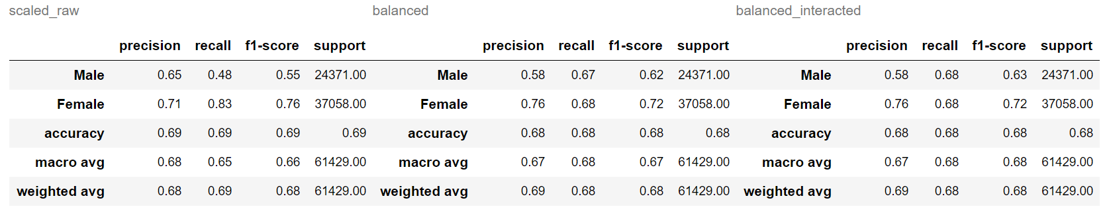
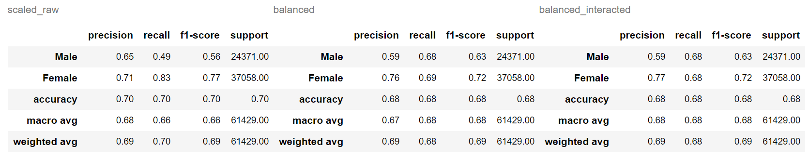
Results – Precision, Recall, F1-score
Logistic regression:
Gradient boosting:

Slide 15
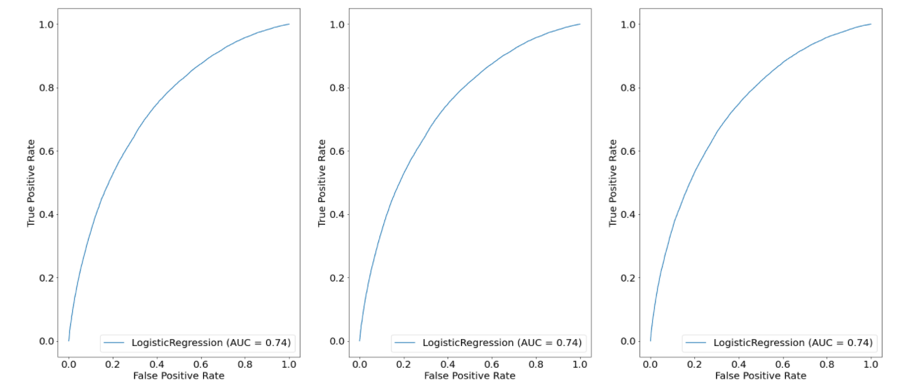
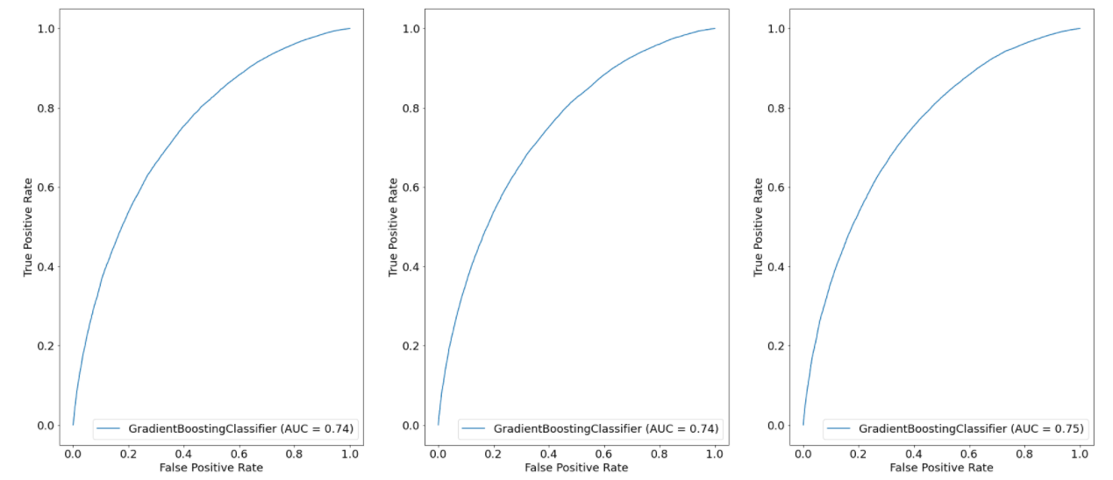
Scaled_raw
Balanced
Balanced_interacted
Results
– ROC curve
Logistic regression:
Gradient boosting:

Slide 16
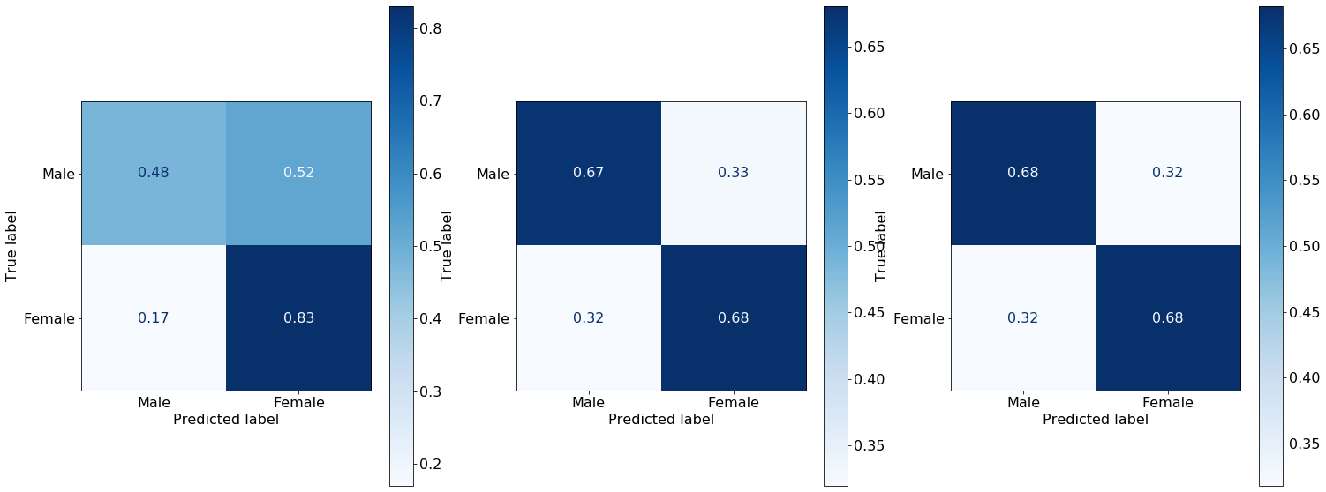
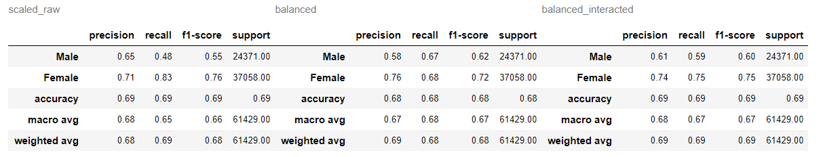

Results – Confusion matrix
Logistic regression:
Gradient boosting:

Slide 17
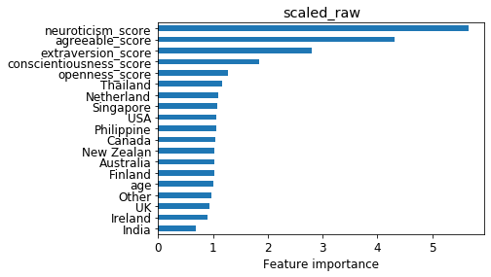
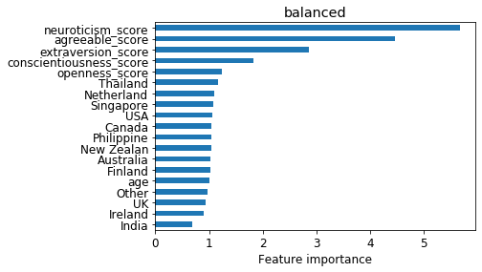
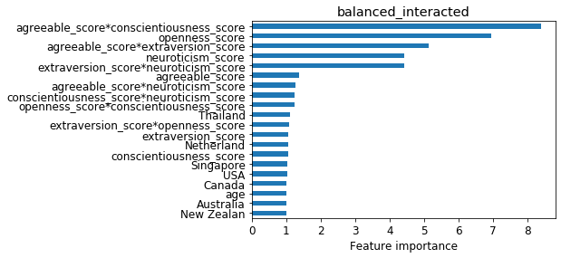

Explainability – Logistic regression
Calculated by:

Slide 18
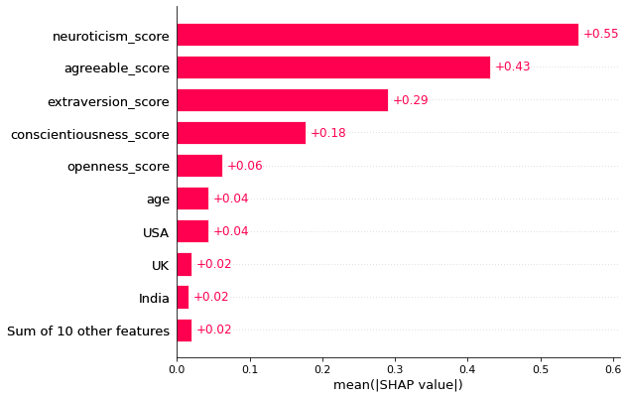
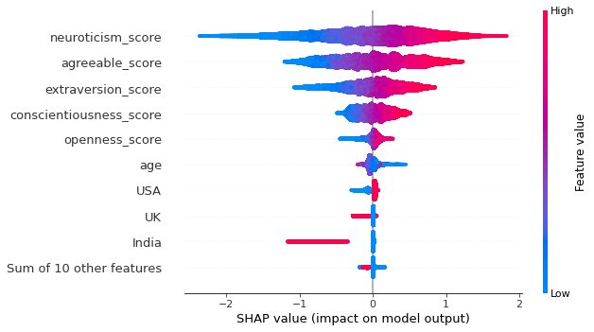
Explainability – Gradient Boosting - SHAP
Scaled raw data

Slide 19
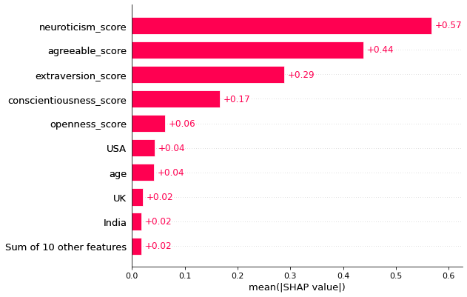
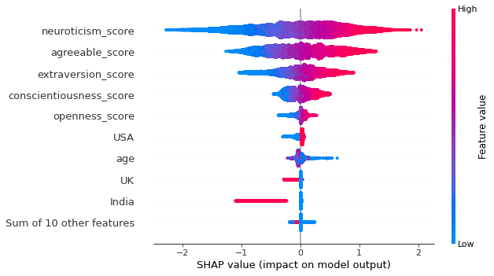
Explainability – Gradient Boosting - SHAP
Balance data

Slide 20
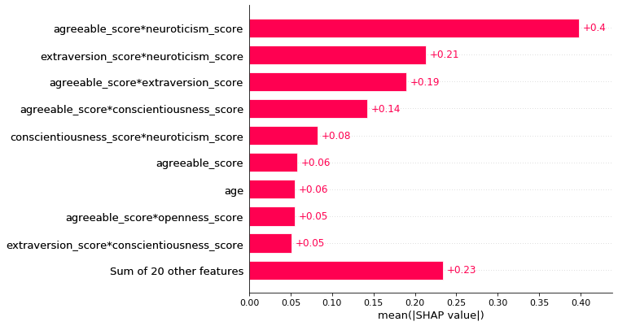
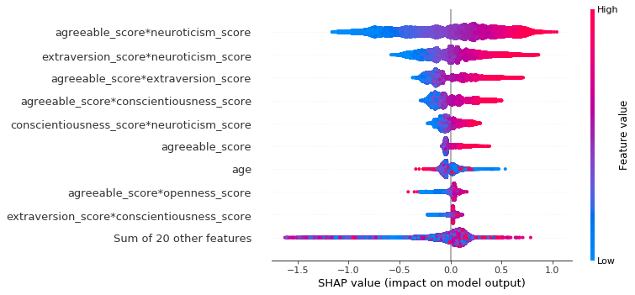
Explainability – Gradient Boosting - SHAP
Balance Interacted data

Slide 21
Conclusions
At first glance and a relatively basic run - women have on average a higher score in the Big Five traits but not at a level that can be used for prediction.
Using the age feature preserved the relative advantage of women over men in scores but not at a significant level, we can see according to the explainability - the “age” feature doesn’t influence the prediction of gender.
We assumed that a division into "Western / Eastern culture“ using K-mean and PCA could lead us to a better separation of the traits over gender, but we did not achieve any success.
Before balancing the data, it was possible to better predict women - not surprising since there was more data of women. Once the data was balanced to suit the global population - the prediction for women and men was also balanced and led to equality in the success of True Positive for both gender. Using the traits interaction bounced back the prediction for the women but hurt the prediction in the men.
For most of the data - one can see that the best explanation is neuroticism and agreeableness (high neuroticism or agreeableness is more likely to be a woman), and indeed from looking at the box plots- their distribution has the most variance between genders (same variance was preserved over the preprocessing).
In the end, the action that led to the most drastic change (in confusion matrix) was the balance of data.
Suggestion for further exploration: changing threshold for a different recall-precision tradeoff.

